Slide 1
Introduction to Programming
Fundamentals of Python Week 2

Slide 2
Coding Rules
Python relies on proper indentation. Incorrect indentation causes an error.
The standard indentation is four spaces.
With implicit continuation, you can divide statements after parentheses, brackets, and braces, and before or after operators like plus or minus signs.
With explicit continuation, you can use the \ character to divide statements anywhere in a line.

Slide 3
Comments
Use comments to describe portions of code that are hard to understand, but don’t overdo them.
Use comments to comment out (or disable) statements that you don’t want to test.
If you change the code that’s described by comments, change the comments too.

Slide 4
Data Types
Data type Name Examples
str String "Mike", "40 ", 'Please enter name: '
int Integer 21 450 0 -25
float Floating-point 21.9 450.25 0.01

Slide 5
Coding Data Types
# sets first_name to a str of "Mike"
first_name = "Mike"
# sets quantity1 to an int of 3
quantity1 = 3
# sets list_price to a float of 19.99
list_price = 19.99

Slide 6
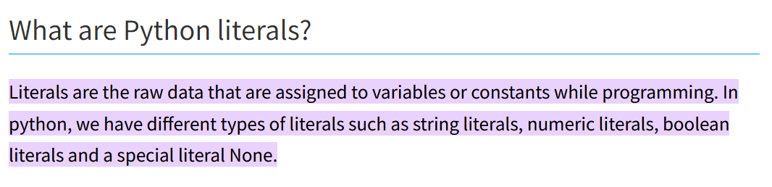
Literal Values
To code a literal value for a string, enclose the characters of the string in single or double quotation marks. This is called a string literal.
To code a literal value for a number, code the number without quotation marks. This is called a numeric literal.

Slide 7
Identifier Naming Rules
A variable name must begin with a letter or underscore.
A variable name can’t contain spaces, punctuation, or special characters other than the underscore.
A variable name can’t begin with a number, but can use numbers later in the name.
A variable name can’t be the same as a keyword that’s reserved by Python.

Slide 8
Python Keywords
and except lambda while
as False None with
assert finally nonlocal yield
break for not
class from or
continue global pass
def if raise
del import return
elif in True
else is try

Slide 9
Naming Conventions
Start all variable names with a lowercase letter.
Use underscore notation or camel case.
Use meaningful names that are easy to remember.
Don’t use the names of built-in functions, such as print().
Examples
variable_name # underscore notation
variableName # camel case

Slide 10
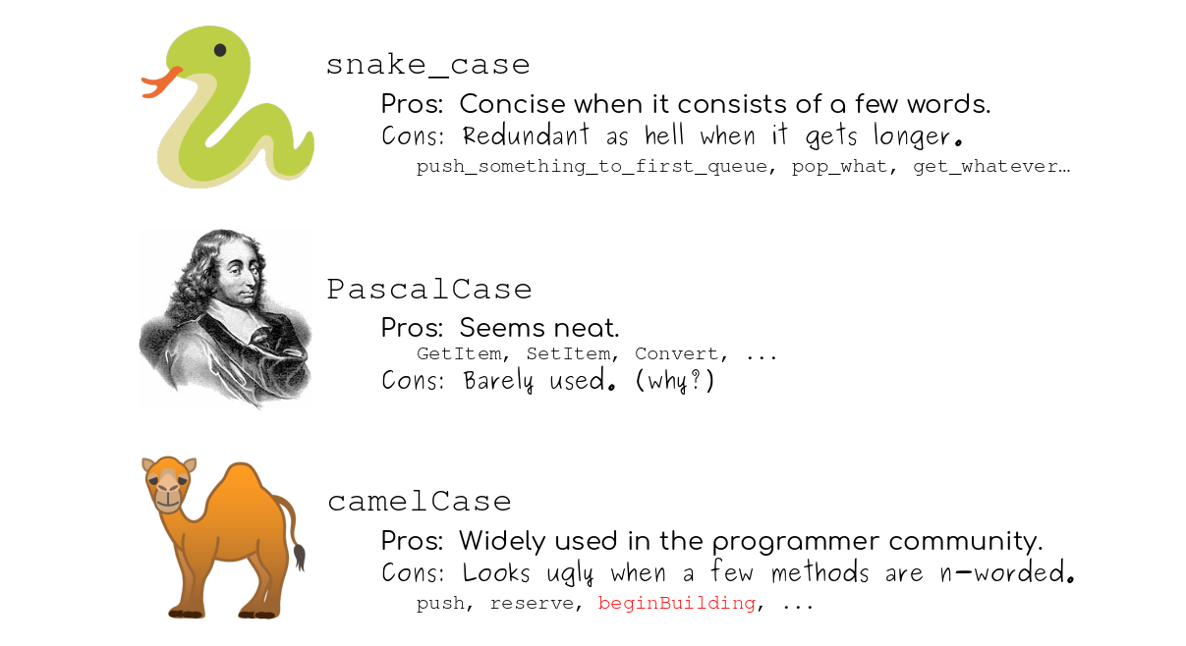
Naming Conventions

Slide 11
Operators

Slide 12
Arithmetic Operators
Operator Name
+ Addition
- Subtraction
* Multiplication
/ Division
// Integer division
% Modulo / Remainder
** Exponentiation

Slide 13
Examples
Example Result
5 + 4 9
25 / 4 6.25
25 // 4 6
25 % 4 1
3 ** 2 9

Slide 14
Order of Precedence
Order Operators Direction
1 ** Left to right
2 * / // % Left to right
3 + - Left to right
Example Result
3 + 4 * 5 23 (the multiplication is done first)
(3 + 4) * 5 35 (the addition is done first)

Slide 15
Coding Examples
Arithmetic Operators
subtotal = 200.00
tax_percent = .05
tax_amount = subtotal * tax_percent # 10.0
grand_total = subtotal + tax_amount # 210.0
Order of Precedence
width = 4.25
length = 8.5
perimeter = (2 * width) + (2 * length) # 25.5

Slide 16
Compound Operators
Compound Operators
+=
-=
*=
Coding Examples
counter = 0
counter = counter + 1 # counter = 1
counter += 1 # counter = 2
score_total = 0 # score_total = 0 score_total += 70 # score_total = 70 score_total += 80 # score_total = 150

Slide 17
Working with Strings

Slide 18
Assigning String Variables
first_name = "Bob" # Bob
last_name = 'Smith' # Smith
name = "" # (empty string)
name = "Bob Smith" # Bob Smith
Str() method converts data type to string

Slide 19
Joining Strings
With the + operator
name = last_name + ", " + first_name # name is "Smith, Bob"
With an f-string
name = f"{last_name}, {first_name}“ # name is "Smith, Bob“
How to join a string and a number
With the + operator and the str() function
name = "Bob Smith"
age = 40
message = name + " is " + str(age) + " years old."
With an f-string
name = "Bob Smith"
age = 40
message = f"{name} is {age} years old.“ # str() function not needed

Slide 20
Escape Sequences
Sequence Character
\n New line
\t Tab
\r Return
\" Quotation mark in a double quoted string
\' Quotation mark in a single quoted string
\\ Backslash

Slide 21
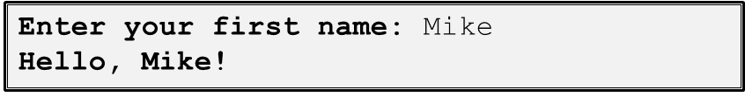
The input() function
input([prompt])
Code that gets string input from the user
first_name = input("Enter your first name: ")
print(f"Hello, {first_name}!")
The console result

Slide 22
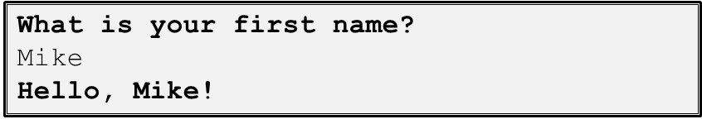
Another input() example
print("What is your first name?")
first_name = input()
print(f"Hello, {first_name}!")
The console result

Slide 23
Working with Numbers

Slide 24
Working with Numbers
Three functions for working with numbers
int(data)
float(data)
round(number [,digits])
Code that causes an exception
x = 15
y = "5"
z = x + y # TypeError: can't add an int to a str
How using the int() function fixes the exception
x = 15
y = "5"
z = x + int(y) # z is 20

Slide 25
Int & Float Examples
Int Examples
quantity = input("Enter the quantity: ") # get str type
quantity = int(quantity) # convert to int type
OR
quantity = int(input("Enter the quantity: "))
Float Examples
price = input("Enter the price: ") # get str type
price = float(price) # convert to float type
How to use chaining to get the value in one statement
price = float(input("Enter the price: "))

Slide 26
Round Examples
miles_driven = 150
gallons_used = 5.875
mpg = miles_driven / gallons_used # 25.53191489361702
mpg = round(mpg, 2) # 25.53
OR
mpg = round(miles_driven / gallons_used, 2)

Slide 27
Testing & Debugging

Slide 28
Goals
The goal of testing
To find all errors before the program is put into production.
The goal of debugging
To fix all errors before the program is put into production.

Slide 29
Types of Errors
Syntax errors
Violate the rules for how Python statements must be written. These errors, also called compile-time errors, are caught by IDLE and the Python compiler before you run the program.
Runtime errors
Don’t violate the syntax rules, but they throw exceptions that stop the execution of the program. Many of these exceptions are due to programming errors that need to be fixed. But some exceptions need to be handled by the program so the program won’t crash.
Logic errors
Statements that don’t cause syntax or runtime errors, but produce the wrong results. In the console for the Future Value program above, the future value isn’t correct, which is a logic error.

Slide 30
Common Syntax Errors
Misspelling keywords.
Forgetting the colon at the end of the opening line of a function definition, if clause, else clause, while statement, for statement, try clause, or except clause.
Forgetting an opening or closing quotation mark or parenthesis.
Using parentheses when you should be using brackets, or vice versa.
Improper indentation.

Slide 31
Problems with Identifiers
Misspelling or incorrectly capitalizing a variable or function name.
Using a keyword as a variable or function name.
Not checking that a value is the right data type before processing it. For example, using a number when it needs to be converted to a string, or vice versa.

Slide 32
Problem with floating-point arithmetic
The float data type in Python uses floating-point numbers, and that can lead to arithmetic results that are imprecise. For example,
sales_amount = 74.95;
discount = sales_amount * .1 # 7.495000000000001
One way to fix this problem is to round the result to the right number of decimal places. If necessary, you can also convert it back to a floating-point number:
discount = round(discount, 2) # 7.5
Another way to fix this problem is to use the standard decimal module, which lets you work with decimal numbers instead of floating-point numbers.

Slide 33
Testing Phases
Test the program with valid input data to make sure the results are correct.
Test the program with invalid data or unexpected user actions. Try everything you can think of to make the program fail.

Slide 34
Making a test plan for the critical phases
List the valid entries that you’re going to make and the correct results for each set of entries. Then, make sure that the results are correct when you test with these entries.
List the invalid entries that you’re going to make. These should include entries that test the limits of the allowable values.

Slide 35
Common Testing Problems
Not testing a wide enough range of entries.
Not knowing what the results of each set of entries should be and assuming that the answers are correct because they look correct.

Slide 36
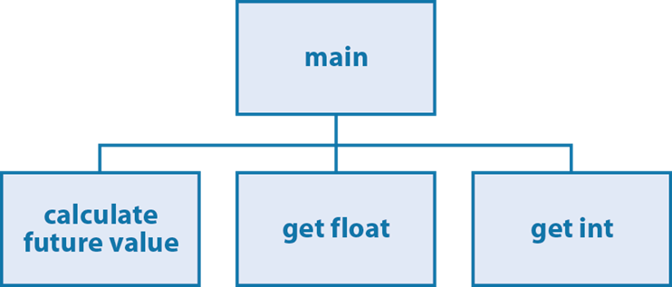
A hierarchy chart for a Future Value program

Slide 37
Testing phase 1: The main() function and the calculate function
Code the calculate_future_value() function.
Code the main() function or at least the portion that calls the calculate_future_value() function and uses the result that’s returned.
Test what you’ve coded so far.

Slide 38
Testing phase 2: Add data validation for float entries
Code the get_float() function.
Modify the main() function so it uses this function to get the float entries.
Test what you’ve coded so far.

Slide 39
Testing phase 3: Add data validation for int entries
Code the get_int() function.
Modify the main() function so it uses this function to get the integer entries.
Test what you’ve coded so far.

Slide 40
Testing phase 4: Add the finishing touches
Make any refinements to the code like improving the prompt messages or the display of the results.

Slide 41
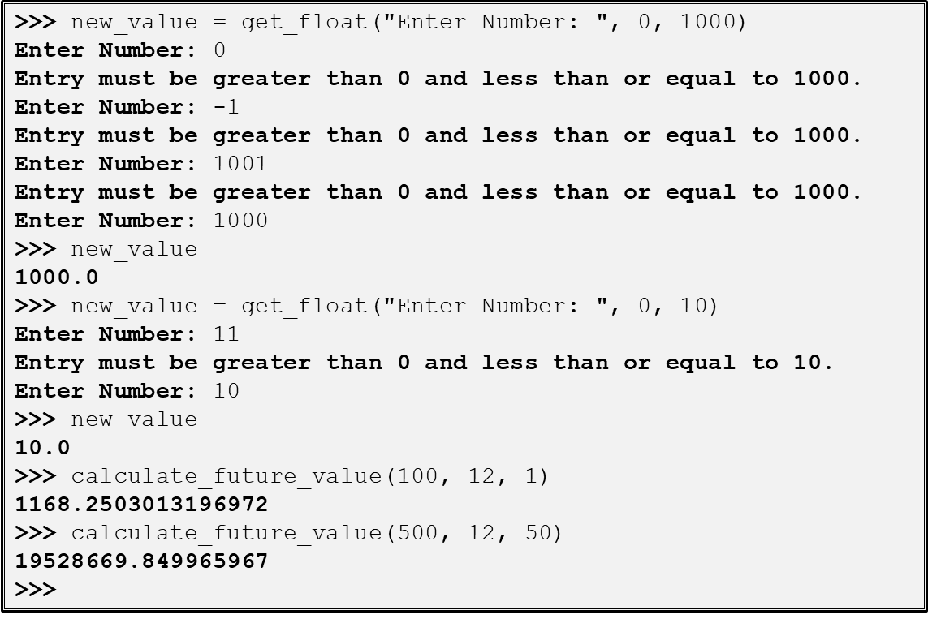
Testing the functions of the Future Value program in the Python shell

Slide 42
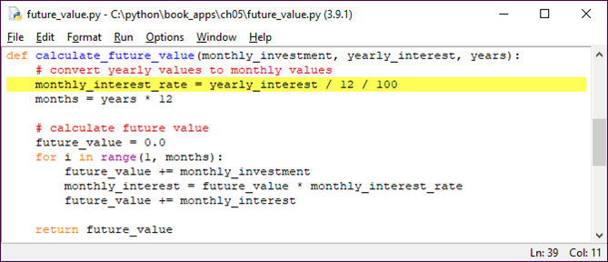
Debugging
Breakpoint
Stop execution of code before a specified line number
A breakpoint at line number 3

Slide 43
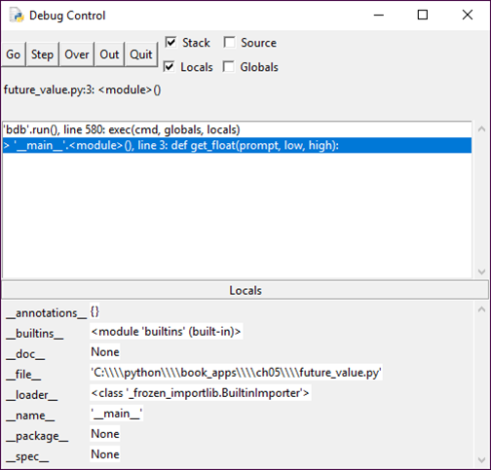
The IDLE Debug Control window when the Future Value program starts
After placing breakpoint

Slide 44
Different Steps
Step into
stop at the first statement of the first function called from the current line
Step over
execute the current statement and all functions that it calls, and then stop before the next statement (or at the first breakpoint on the way, if any)
Step out
run the current function to the end and stop at the statement that follows the function call in the caller's context (or at the first breakpoint on the way, if any)

Slide 45
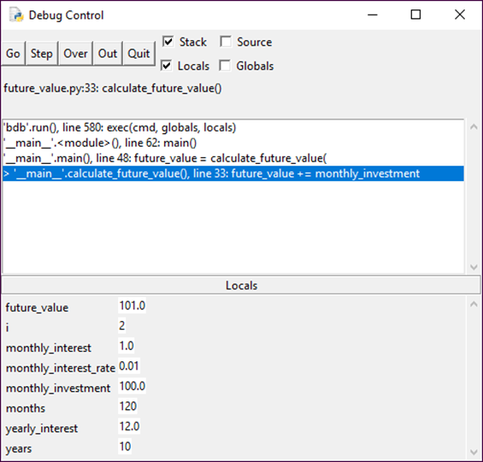
The IDLE Debugger when the Future Value program is running

